Slide 1





Arizona Space Grant Symposium
April 20, 2024 University of Arizona, Manuel Pacheco ILC
Bridges to Belonging
Katrina Robertson
Department of Mechanical Engineering, College of Engineering
Taylor Hobbs
Department of Software Engineering, College of Engineering
Chanel Davis and Trey Talko
Department of Aerospace Engineering, College of Engineering
Faculty Mentors:
Dr. Ashley Rea and Dr. Jonathan Adams
Department of Humanities and Communication, College of Arts and Sciences

Slide 2


Introduction
Women in the engineering classroom experience marginalization in team settings
Direct communicative solutions are often unsuccessful
Highly impactful interventions are often, time and labor intensive
Notes:
1: “Negative impacts on students’ sense of belonging”
2: “Mediation techniques are often attempted too late, or they are not addressing the root of the problem”

Slide 3
The ongoing issue
1. Incidents where women’s personality/ communication style is faulted are almost exclusively enacted by men
2. Singling female students out instantly identifies them as different to those in the setting
"Sometimes I feel people try to make things easier for me since I am a girl, but I try to never take advantage of that…”
““You need to practice a poker face” because I’m very expressive and what- ever I’m thinking it comes off on my face and it’s not “good.””
Notes:
Research in yellow correlates directly with some of the findings from interviews

Slide 4
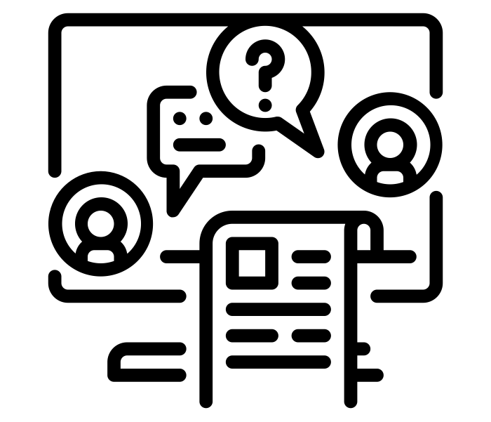
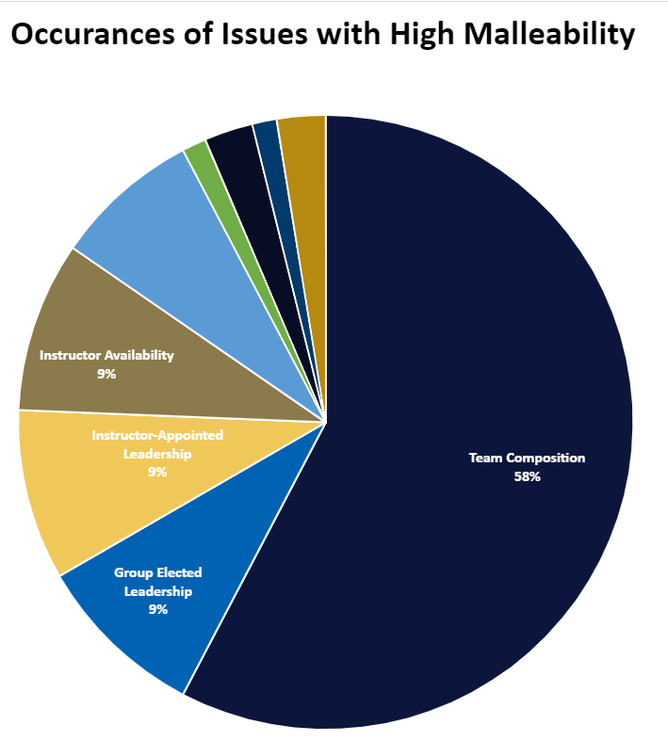
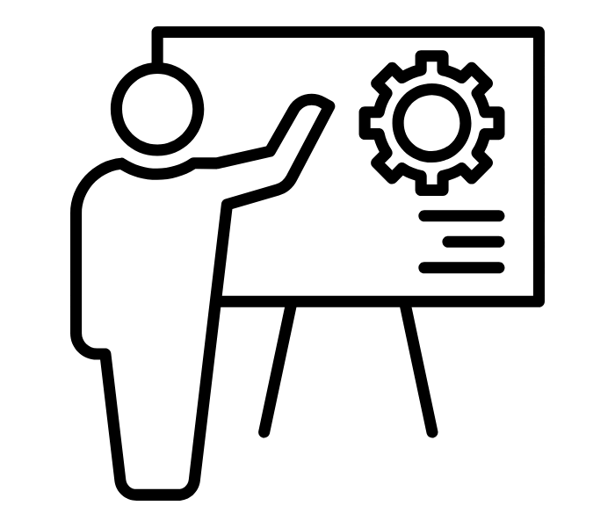
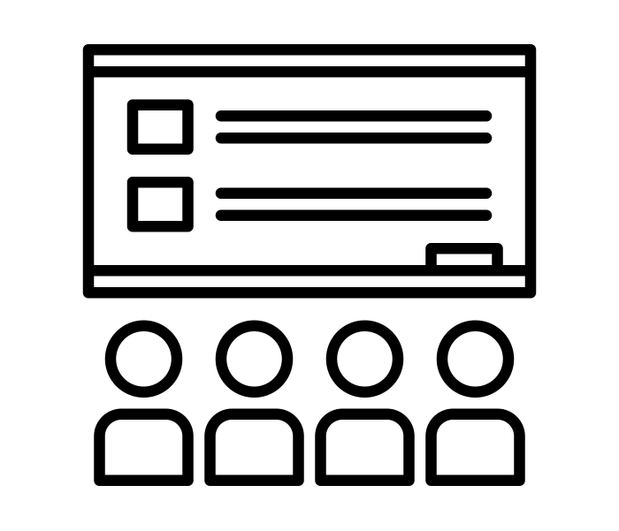
Preceding research
Fall 2022
Spring 2023
Present
Interviews with students and faculty
Applying findings and designing classroom interventions
Summer 2023
Publish and present conclusions and recommendations
Data analysis and infrastructure implementation

Slide 5
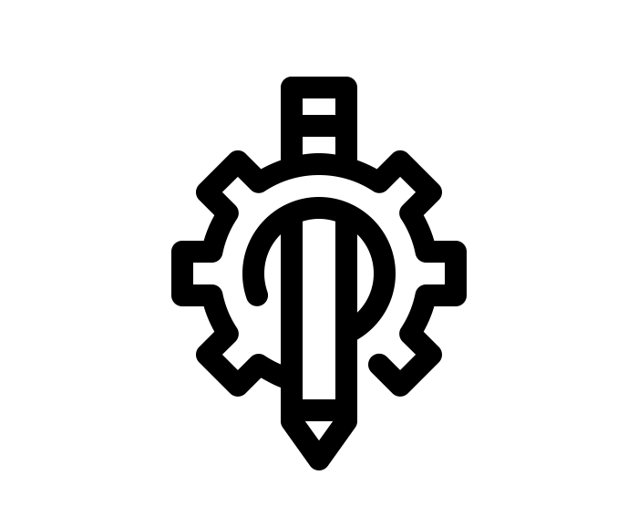
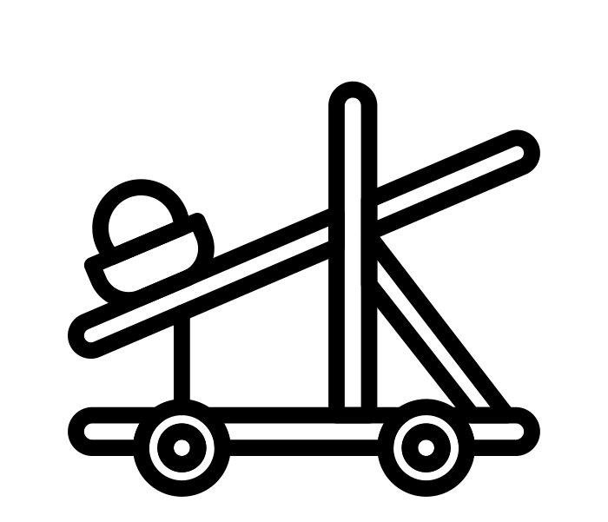


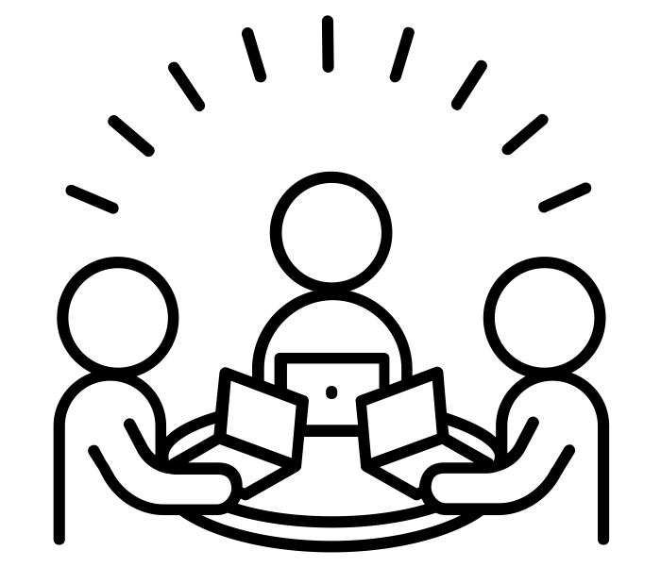
Research basis and proposed outcomes
Student perspective
Base metrics for intentional teaming for course curriculum
Established a line of communication for who they naturally gravitate towards
Instructor perspective
Naturally exposed their skillsets and communication styles
Given the opportunity to observe student interactions early-on
Designed an icebreaker activity at the start of the Fall 2023 semester:
low-cost, minimal class-time allotment, and high student engagement

Slide 6


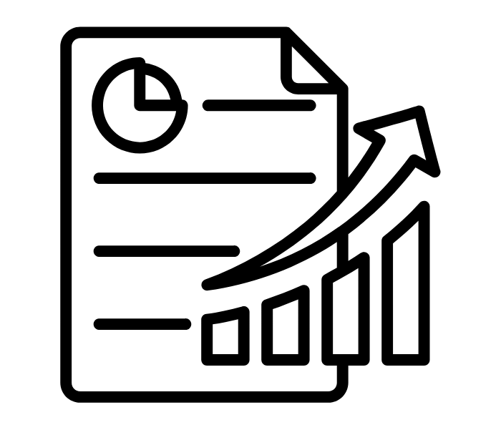
Analyzing qualitative data
Sent Microsoft Forms Survey to students in the class
Interviewed instructors
Employing personal experiences to measure change in classroom culture
Asked questions to gain insight into students’ personal and academic experience in the classroom
Evaluated control vs. test course sections on interpersonal and technical success
Continuing to discuss possible methods to implement for greater improvement in culture

Slide 7
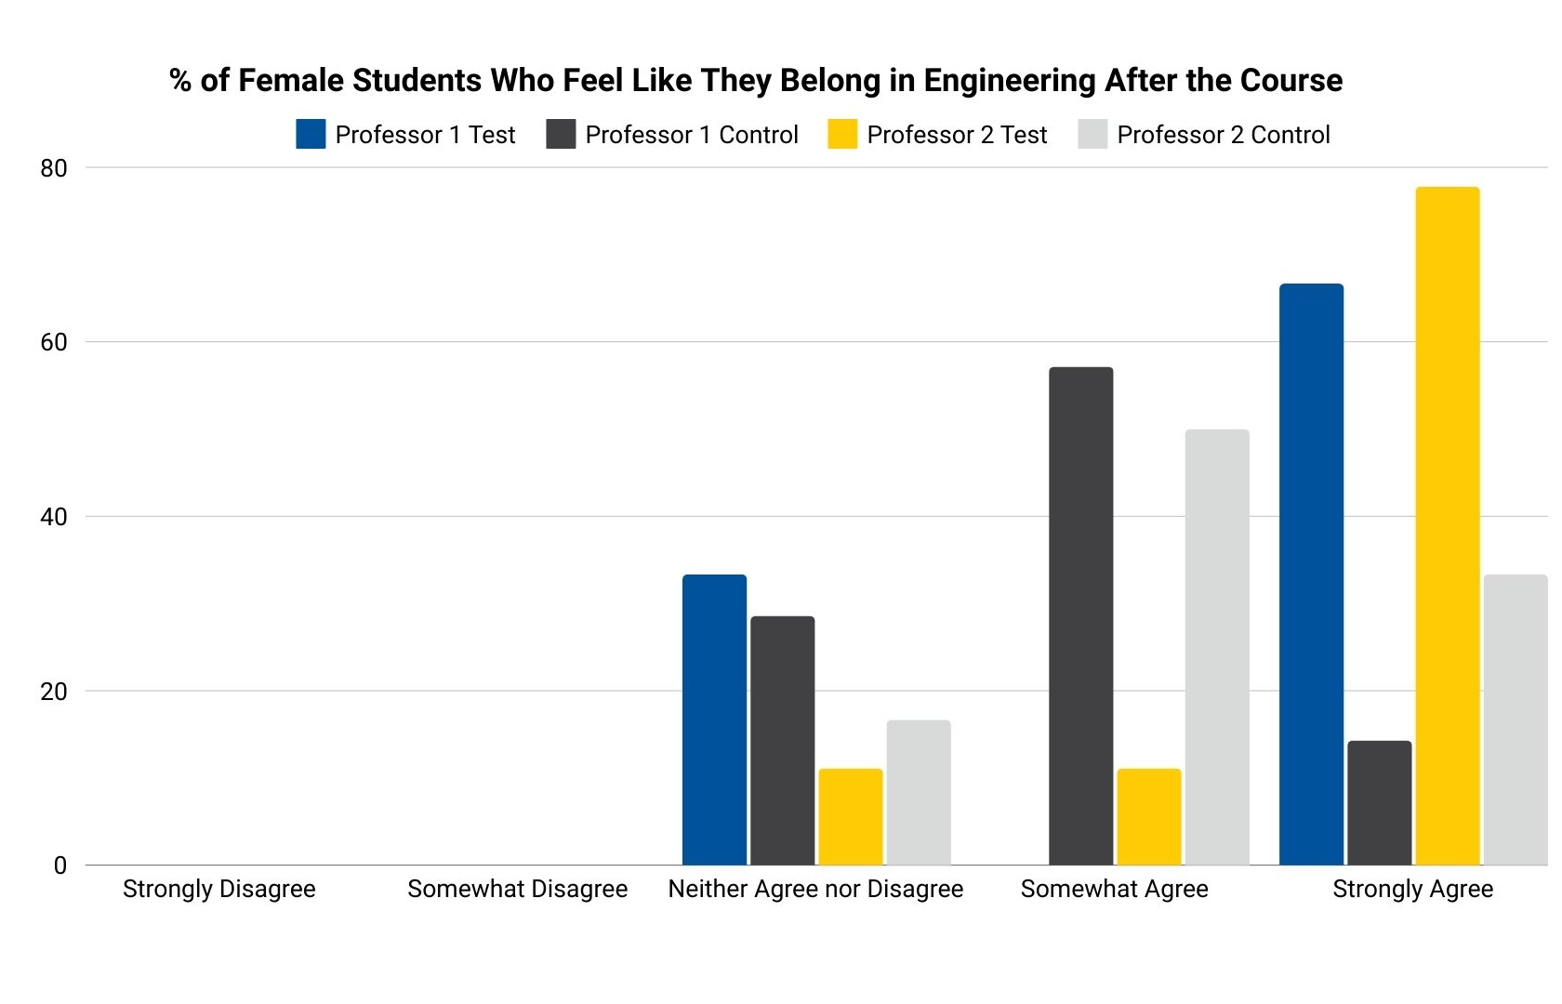
Early findings and interpretations

Slide 8
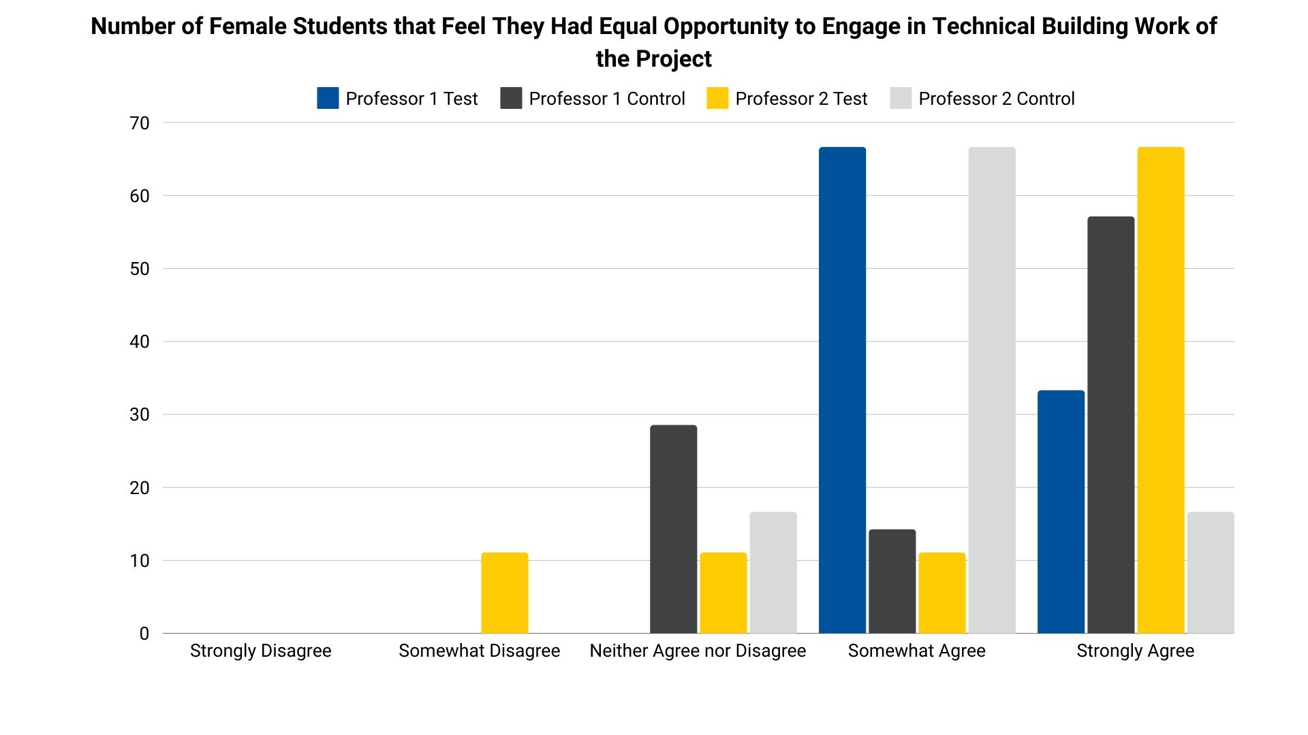
Early findings and interpretations

Slide 9
Final remarks and upcoming analysis
“It wasn’t that 100% of my test teams were all better than 100% of the control groups, but if it were a normal distribution, certainly there is a noticeable difference as a class”
- Instructor #2

Slide 10
Final remarks and upcoming analysis
“To try to say, you guys are struggling right out of the gate. Let’s try to help you, let’s give you a team where you’re more likely to have this positive experience and successful experience.”
- Instructor #2

Slide 11
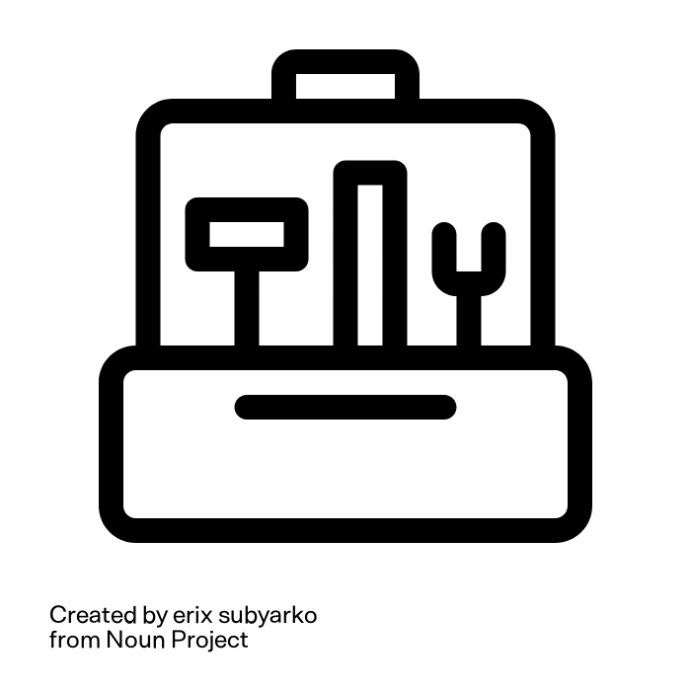
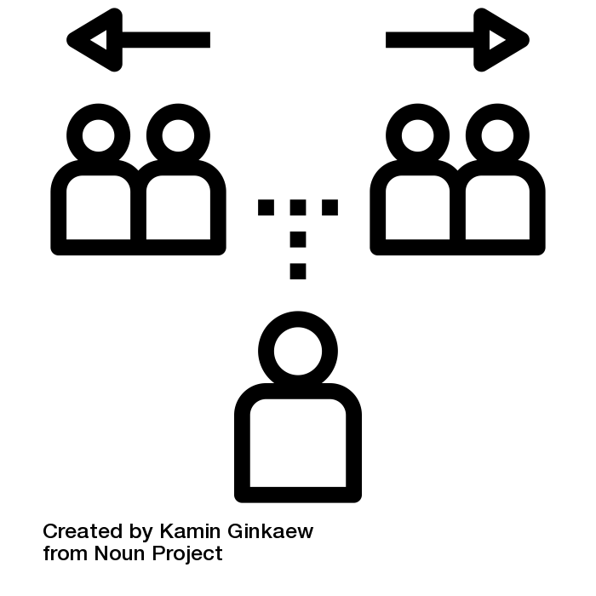
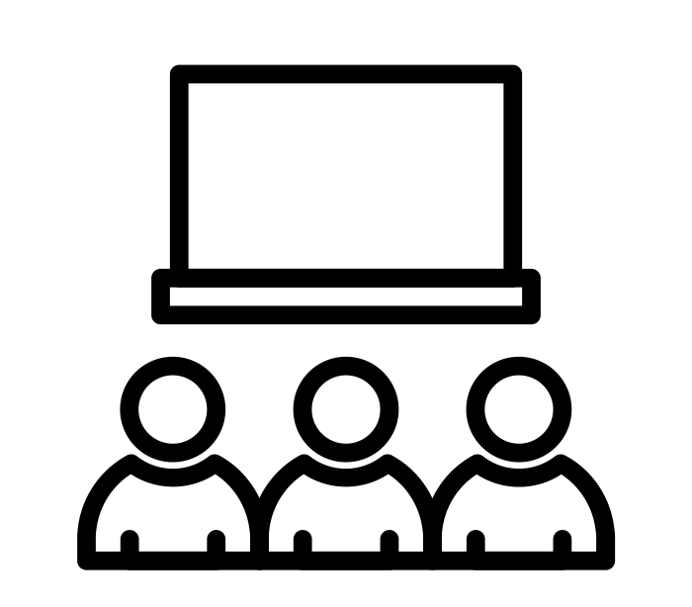
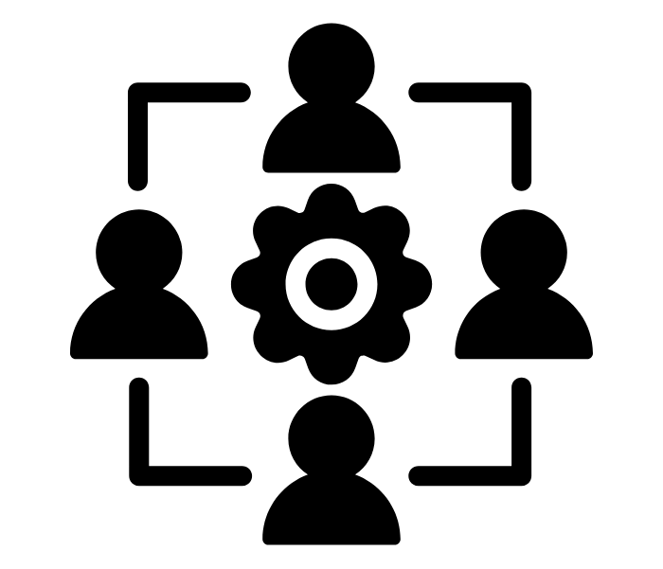
Project Summary
Goal: create more inclusive spaces for women in engineering education
Compose teams intentionally
Provide instructors with teaming strategies
Employ student feedback and input
Affirm the significance of the team itself

